Slide 1
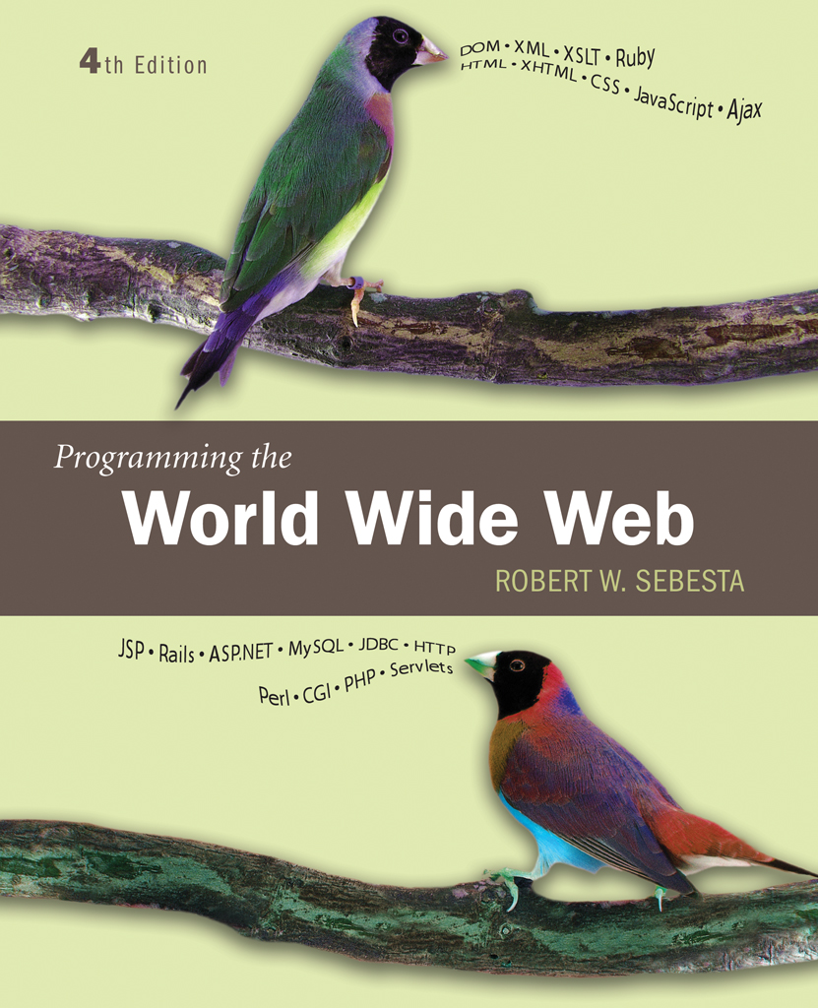
Chapter 1
Fundamentals

Slide 2
1.1 A Brief Intro to the Internet
Internet History
Internet Protocols

Slide 3
1.1 Internet History
Origins
  ARPAnet - late 1960s and early 1970s
    Network reliability
    For ARPA-funded research organizations
BITnet, CSnet - late 1970s & early 1980s
    email and file transfer for other institutions
  NSFnet - 1986
    Originally for non-DOD funded places
    Initially connected five supercomputer centers
    By 1990, it had replaced ARPAnet for non-military uses
    Soon became the network for all (by the early 1990s)
  NSFnet eventually became known as the Internet

Slide 4
1.1 Internet History
What the Internet is:
    A world-wide network of computer networks
    At the lowest level, since 1982, all connections use TCP/IP
    TCP/IP hides the differences among devices connected to the Internet

Slide 5
1.1 Internet Protocols
Internet Protocol (IP) Addresses
  Every node has a unique numeric address
  Form: 32-bit binary number
    New standard, IPv6, has 128 bits (1998)
Organizations are assigned groups of IPs for their computers
Problem: By the mid-1980s, several different protocols had been invented and were being used on the Internet, all with different user interfaces (Telnet, FTP, Usenet, mailto)

Slide 6
1.1 Internet Protocols
Domain names
  Form: host-name.domain-names
  First domain is the smallest; last is the largest
  Last domain specifies the type of organization
  Fully qualified domain name - the host name and all of the domain names
  DNS servers - convert fully qualified domain names to IPs

Slide 7
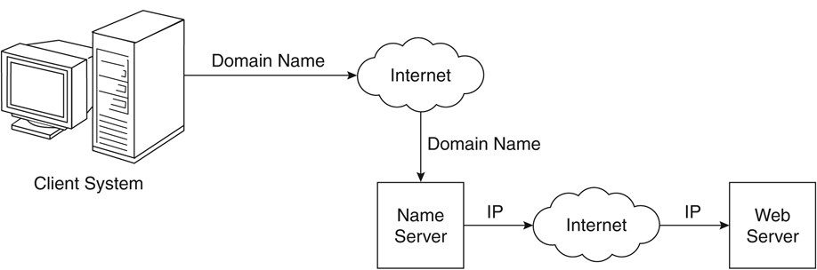
Figure 1.1 Domain name conversion

Slide 8
Client and Server
Clients and Servers are programs that communicate with each other over the Internet
A Server runs continuously, waiting to be contacted by a Client
  Each Server provides certain services
  Services include providing web pages
A Client will send a message to a Server requesting the service provided by that server
  The client will usually provide some information, parameters, with the request

Slide 9
1.2 The World-Wide Web
A possible solution to the large number of different protocols being used on the Internet
Origins
  Tim Berners-Lee at CERN proposed the Web in 1989
    Purpose: to allow scientists to have access to many databases of scientific work through their own computers
  Document form: hypertext
  Pages? Documents? Resources?
    We’ll call them documents
  Hypermedia – more than just text – images, sound, etc.

Slide 10
1.2 The World-Wide Web
Web or Internet?
  The Web uses one of the protocols, http, that runs on the Internet--there are several others (telnet, mailto, etc.)

Slide 11
1.3 Web Browsers
Browsers are clients - always initiate, servers react (although sometimes servers require responses)
Mosaic - NCSA (Univ. of Illinois), in early 1993
  First to use a GUI, led to explosion of Web use
  Initially for X-Windows, under UNIX, but was ported to other platforms by late 1993
Most requests are for existing documents, using HyperText Transfer Protocol (HTTP)
  But some requests are for program execution, with the output being returned as a document
Name some of the Web Browsers?

Slide 12
1.4 Web Servers
Provide responses to browser requests, either existing documents or dynamically built documents
Browser-server connection is now maintained through more than one request-response cycle
All communications between browsers and servers use Hypertext Transfer Protocol (HTTP)
Port number for HTTP? and HTTPS?

Slide 13
1.4 Web Server Operation
Web servers run as background processes in the operating system
  Monitor a communications port on the host, accepting HTTP messages when they appear
All current Web servers came from either
    The original from CERN
    The second one, from NCSA
Most common server now is Apache

Slide 14
1.4 Web Server Operation Details
The file structure of Web servers have two main directories:
    Document root (servable documents)
    Server root (server system software)
Document root is accessed indirectly by clients
  Its actual location is set by the server configuration file
  Requests are mapped to the actual location
Virtual document trees (servable documents from the secondary areas)
Virtual hosts (servers support more than one site on a computer
Proxy servers (Servers serving documents from the document root of other machine)
Web servers now support other Internet protocols

Slide 15
1.4 Web Server Operation : Apache
Apache (open source, fast, reliable)
3 config files of Apache server:
  Httpd.conf
  Srm.conf
  Access.conf
Different directives are available in
http://httpd.apache.org/docs/2.2/mod/quickreference.html
Basically designed for UNIX systems

Slide 16
1.4 Web Server Operation : IIS
IIS for windows systems
  Operation is maintained through a program (IIS snap-in) with a GUI interface
  Operations of Apache is controlled by configuration files

Slide 17
1.5 URLs
General form:
  Format: object-address
  The scheme is often a communications protocol, such as telnet or ftp
For the http protocol, the object-address is:
//fully-qualified-domain-name/path-to-document
For the file protocol, only the doc path is needed
file://path-to-document

Slide 18
1.5 URLs
Host name may include a port number, as in zeppo:80 (80 is the default, so this is silly)
URLs cannot include spaces or any of a collection of other special characters (semicolons, colons, ...)
The doc path may be abbreviated as a partial path
  The rest is furnished by the server configuration
If a special character has to be entered then % with its hexadecimal ASCII code should be included
Eg: if domain name ‘RV CE’ has to be specfied then it has to be written as ‘RV%20CE’ (20 is ASCII code for space)

Slide 19
1.6 Multipurpose Internet Mail Extensions (MIME)
Used by the browsers for deciding the format of doc received by the web server
Originally developed for email
Attached by the server to the beginning of the document
Type specifications
  Form:
    type/subtype
  Common types are: text, image and video
  Common subtypes are: plain, html, gif, jpeg, mpeg, quicktime
  Examples: text/plain, text/html, image/gif, image/jpeg

Slide 20
1.6 Multipurpose Internet Mail Extensions (MIME)
Server gets type from the requested file name’s suffix (.html implies text/html)
Browser gets the type explicitly from the server
Experimental sub types
Subtype begins with x-
e.g., video/x-msvideo
Experimental types require the server to send a helper application or plug-in so the browser can deal with the file

Slide 21
1.7 The HyperText Transfer Protocol
The protocol used by ALL Web communications
Request Phase
  Form:
  HTTP method domain part of URL HTTP ver.
  Header fields
  blank line
  Message body
  An example of the first line of a request:
    GET /degrees.html HTTP/1.1

Slide 22
1.7 The HyperText Transfer Protocol: Methods
GET - Fetch a document
POST - Execute the document, using the data in body
HEAD - Fetch just the header of the document
PUT - Store a new document on the server
DELETE - Remove a document from the server

Slide 23
1.7 HTTP Headers
Four categories of header fields:
  General, request, response, & entity
Common request fields:
  Accept: text/plain
  Accept: text/*
  If-Modified_since: date
Common response fields:
  Content-length: 488
  Content-type: text/html
Can communicate with HTTP without a browser
  > telnet blanca.uccs.edu http
  GET /respond.html HTTP/1.1
  Host: blanca.uccs.edu connection:keep-alive ---- ------ ------- hello world

Slide 24
1.7 HTTP Response
Form:
  Status line
  Response header fields
  blank line
  Response body
Status line format:
  HTTP version status code explanation
Example: HTTP/1.1 200 OK
  (Current version is 1.1)
Status code is a three-digit number; first digit specifies the general status
  1 => Informational
  2 => Success
  3 => Redirection
  4 => Client error
  5 => Server error
The header field, Content-type, is required

Slide 25
1.7 HTTP Response Example
HTTP/1.1 200 OK
Date: Tues, 18 May 2004 16:45:13 GMT
Server: Apache (Red-Hat/Linux)
Last-modified: Tues, 18 May 2004 16:38:38 GMT
Accept-ranges: bytes
Content-length: 364
Connection: close
Content-type: text/html, charset=ISO-8859-1
Both request headers and response headers must be followed by a blank line

Slide 26
1.7 Status code Example
Example for status code are
  404 --- file not found
  200 --- OK(Successful Request)
  500 --- Server encountered a problem
  202- Accepted for processing

Slide 27
1.8 Security
Both Web Browsers and Servers are unsafe !!!??
Security issues are
  Privacy: it shouldn’t be possible to steal the data while transmitting
  Integrity: it shouldn’t be possible to modify the data while transmitting
  Authentication: it should be possible for both ends to be certain of each others identity
  Nonrepudiation: it should be possible to legally prove that the message was actually sent and received
Encryption is the tool for resolving security issues
  Symmetric key encryption
  Public key encryption

Slide 28
1.8 Security
Some more security problems are
  DoS
  Viruses
  Worms

